Slide 1
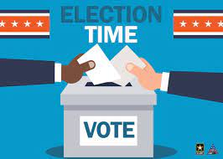
American Elections
8th Grade US History Lesson Plan
Ty Barrett
EDUC 5313

Slide 2


Standards
This lesson is designed to help satisfy Oklahoma Academic Standard for Social Studies 8th Grade (US History) 8.3.10
ISTE Standards
Students-
1.1 Empowered Learner
1.2 Digital Citizen
1.7 Global Collaborator
Educators-
2.2 Leader
2.3 Citizen

Slide 3

Background Info
American Elections are essentially based upon a 2 party system, in which each political party holds a primary and then those winners go head to head in a general election.
Only registered members of the specific party may vote in their party’s primary
You must register to vote to be able to vote. States have control over the requirements of doing this. Many states require you register weeks before election day.
Oklahoma

Slide 4

Brainstorm
We will be creating a list of topics to be able to vote on during our elections. Elections are more than just the president, there are many races on the ballot that citizens vote for.
We need topics that can be divided into 2 different categories (or parties)
Example- Candy (Bar Candy vs. Non-Bar Candy)
Then we will need suggestions for what will be the options in each category or party
Example- Snickers in Candy Bar Party, and Sour Patch Kids in Non-Bar Candy Party

Slide 5

Caucus
Some states in place of a traditional primary use something called a caucus to decide their party’s candidate or how their delegates will be divided.
We are going to caucus to create some of our primary voting ballot.
We will caucus to decide a male and female student in each class. The winner in each class will move to the next primary and compete against students from my other classes.
VOLUNTEERS NEEDED FOR FEMALE STUDENT AND MALE STUDENT
LET’S CAUCUS

Slide 6
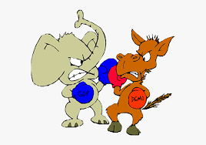
Primary
Choose Your Party
Party 1 Categories-
Candy (Bars), Fast Food (Chicken), Ice Cream (Simple), Drinks (Non Soda), Pizza (Non-meat Toppings), Teachers (Male), Movies (Animated), Students (Female), Heroes (DC), Weekdays, Thanksgiving Sides, Colors (Primary), Animals (Domesticated), Restaurant (Pizza), Sports (winter/spring), TV Shows (Comedy), Seasons (Cold), Dog Breeds (Large), Cars (Domestic), Holidays (winter/ fall), Subjects (elective), Phobias (insect/animal), Chips (non-traditonal)

Slide 7
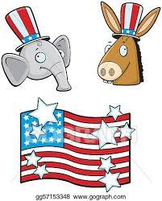
Primary
Choose Your Party
Party 2 Categories-
Candy ( Non-Bar), Fast Food (Non-chicken), Ice Cream (w add ins), Drinks (Soda), Pizza (Meat Toppings), Teachers (Female), Movies (Non-animated), Students (Male), Heroes (Marvel), Weekend Days, Thanksgiving Desserts, Colors (Secondary), Animals (Wild), Restaurants (Steakhouse), Sports (fall/ spring), TV Shows (Action/ Drama), Seasons (Warm), Dog Breeds (Small), Cars (Foreign), Holidays (Summer/ Spring), Subjects (core), Phobias (Non-animal), Chips (Traditional)

Slide 8

Primary Results
Party 1
Hershey’s, Chick-fil-a, Chocolate Ice Cream, Lemonade. Cheese Pizza, The Bee Movie, Coach McGrew, Makenzi, Batman, Friday, Stuffing, Blue, Dogs, Pizza Hut, Basketball, Spongebob, Fall, Pit Bull, Dodge, Christmas, PE/ Health, Spiders, Takis

Slide 9

Primary Results
Party 2
Sour Patch Kids, McDonalds, Cookie Dough Ice Cream, Dr. Pepper, Pepperoni Pizza, Ms. Taha, Spider-Man: No Way Home, Michael, Spider-Man, Saturday, Pumpkin Pie, Purple, Penguin, Texas Roadhouse, Football, The Flash, Summer, Corgi, BMW, Easter, Math, Heights, Doritos

Slide 10
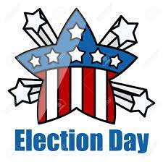
General Election
Sour Patch Kids vs. Hershey’s, McDonalds vs. Chick-fil-a, Cookie Dough Ice Cream vs. Chocolate Ice Cream, Dr. Pepper vs. Lemonade, Pepperoni pizza vs. Cheese pizza, Ms. Taha vs. Coach McGrew, Spider-Man: No Way Home vs. The Bee Movie, Michael vs. Makenzi, Spider-Man vs. Batman, Saturday vs. Friday, Pumpkin Pie vs. Stuffing, Purple vs. Blue, Penguin vs. Dog, Texas Roadhouse vs. Pizza Hut, Football vs. Basketball, The Flash vs. Spongebob, Summer vs. Fall, Corgi vs. Pit Bull, BMW vs. Dodge, Easter vs. Christmas, Math vs. PE/ Health, Fear of heights vs. Fear of spiders, Doritos vs. Takis

Slide 11
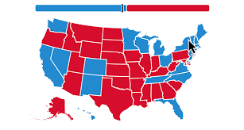
General Election Results
Sour patch Kids- 63.8 Chick-fil-a 71.4
Cookie Dough-63.8 Dr. Pepper- 71.4
Pepperoni pizza- 64.8 Ms. Taha- 56.2
Spider-Man: NWH- 53.2 Michael- 68.6
Spider-Man- 67.6 Saturday- 54.3
Pumpkin Pie- 53.3 Purple- 56.2
Dog- 68.6 Texas Rdhouse- 68.6
Football- 56.2 Spongebob- 81.9
Fall- 51.4 Pitbull 72.4
BMW- 58.1 Christmas- 95.2
PE/ Health- 66.7 Heights- 59
Takis- 53.3

Slide 12

Election Summary
Reviewing Key Terms-
Ballot
Political Parties
Run-off Election
Primary Election
Caucus
Winner-Take-All Election
Run-off Election
General Election
Electoral College

